Slide 1
British Airways Virtual Work Experience
Task 1
Web Scraping to gain company insights.

Slide 2
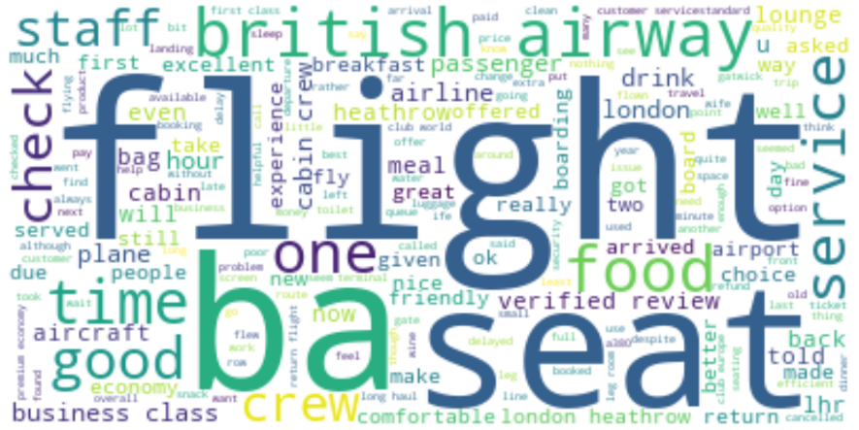
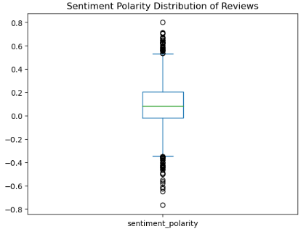
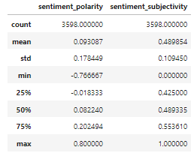
Customer Review Analysis
Food, Drink, Breakfast, Service, Meal, Served suggest that Food Services have been reviewed frequently by the customers.
Seat, Cabin, Business Class, Economy, Bag, Lounge, Service, Boarding, Airport suggest that these Airline Operation Services have been reviewed.
Staff, Service, Cabin Crew, Customer Services Standard suggest that Airline Staff has been reviewed by the customers.
The mean sentiment polarity is close to zero suggesting that the average sentiment expressed about the airline is neutral.
Box plot outliers show that there are more “negative” reviews than “exceptionally positive” reviews.

